Slide 1
Project 1: Good Cardio Fitness Case Study
Data Science and Business Analytics
Krithika Srinivasan

Slide 2
Objectives
Come up with a customer profile (characteristics of a customer) of the different products
Perform uni-variate and multi-variate analyses
Generate a set of insights and recommendations that will help the company in targeting new customers

Slide 3
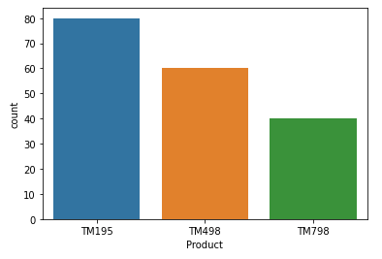
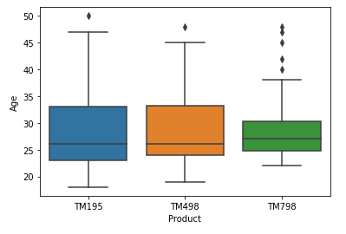
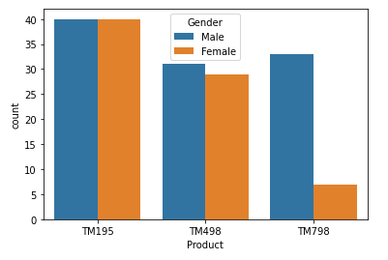
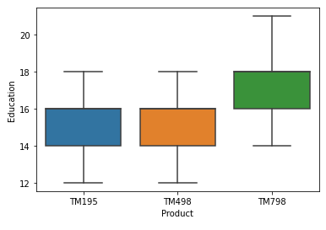
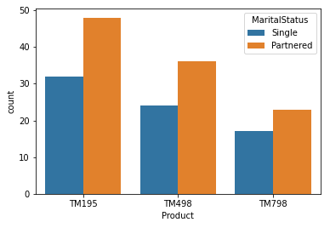
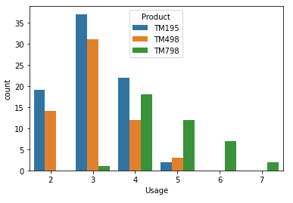
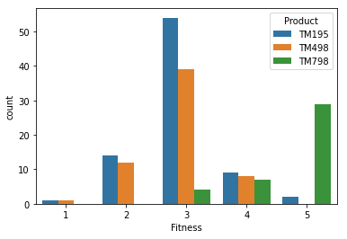
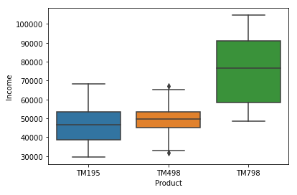
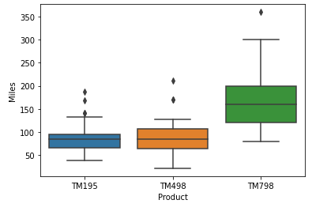
Customer Profile for Product TM195
Maximum number of customers bought this product; suggesting that this is a popular product
Average age of customers who bought this product is 28.5, with 50% of the customers being below 26 years of age
This product is not preferred by one gender- both males and females have purchased this product equally
This product has mostly been purchased by customers who have had 14-16 years of education
This product has mostly been purchased by customers whose marital status is ‘Partnered’
The product has mostly been purchased by customers who like to walk/run 2-5 times a week; but mostly ~3 times a week
Fitness level of customers who bought this product is mostly 3
The average income of customers who buy this product is $ 46K; which is lower than the other two products; suggesting that this product might be very suitable for those who have a relatively low income
This product has mostly been purchased by customers who are expected to walk/run an average of 82 miles a week

Slide 4
Customer Profile for Product TM498
2nd most bought product
Average age of customers who bought this product is 28.9, with 50% of the customers being below 26 years of age
This product is slightly more preferred by males over females
This product has mostly been purchased by customers who have had 14-16 years of education
This product has mostly been purchased by customers whose marital status is ‘Partnered’
The product has mostly been purchased by customers who like to walk/run 2-5 times a week; but mostly ~3 times a week.
Fitness level of customers who bought this product is mostly 3
The average income of customers who buy this product is $ 49K; but the range of income is smaller compared to the other two products; suggesting that this product might be very suitable for those whose income lies between $ 45K - $ 50K
This product has mostly been purchased by customers who are expected to walk/run an average of 88 miles a week

Slide 5
Customer Profile for Product TM798
Least bought product
Average age of customers who bought this product is 29.1, with 50% of the customers being below 27 years of age
This product is highly preferred by males compared to females
This product has mostly been purchased by customers who have had 16-18 years of education
This product is preferred by customers whose marital status is ‘Partnered’
The product has mostly been purchased by customers who like to walk/run 4-7 times a week; but mostly ~5 times a week; suggesting that it is better suited for those who run/walk more
Fitness level of customers who bought this product is mostly 5; suggesting this product is preferred by those who are fit and exercise regularly
The average income of customers who buy this product is $ 75K; but the range of income is smaller compared to the other two products; suggesting that this product is suitable for those customers that are in the higher income bracket
This product has mostly been purchased by customers who are expected to walk/run an average of 166 miles a week

Slide 6
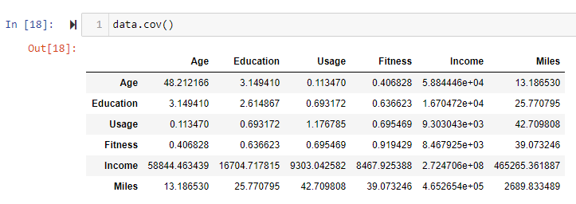
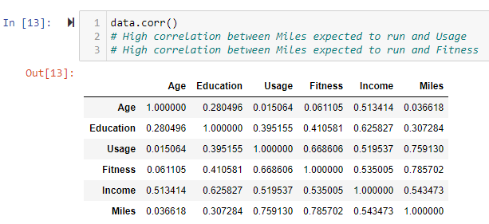
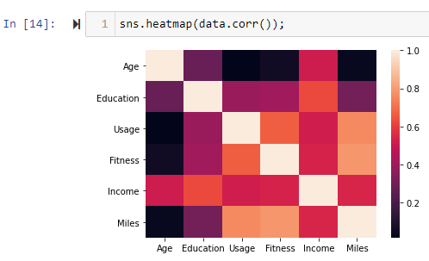
Multi-Variate Analyses
Covariance
Correlation
Covariance does not give insights into the causation of different features
We will look at correlation instead
Correlation is high between:
Expected Miles and Usage
Expected Miles and Fitness

Slide 7
Insights and Recommendations
Out of the three products, the most bought product is TM195
This product could be used to target customers who:
walk/run ~3 times a week
have a fitness level of 3
Are in the low-income bracket
In the ‘Partnered’ marital status group

Slide 8
Insights and Recommendations
The company can use product TM498 to target a customer base that is similar to the customer base for TM195. A few distinctions from TM195:
Since the product is preferred by males, it could be used to target a male customer base
Since the average income is higher for this product, this could be used to target a customer base with income between $ 45K - $ 50K

Slide 9
Insights and Recommendations
TM798 seems to be a product with a niche customer base. Could be used to target customers who:
Are younger
Are male since this product is highly preferred by males compared to females
Are highly educated
Walk/run ~5 times a week
Are very fit
Are in the high-income bracket

Slide 10
Appendix

Slide 11
All Plots

